Slide 1


Python Workshop: Intermediate
Spring 2020

Slide 2
General Topics we’ll cover
Python Environments
Anaconda
Installing packages
ArcGIS API for Python
Querying data
Spatial Dataframes
pandas syntax
Editing data
Cleaning your code
Commenting
Documenting
Creating your own package
And more…

Slide 3
Python Environments
ArcGIS Pro comes with a default environment
Has arcpy installed
Cannot be changed/upgraded
Can be “cloned”
When to create a new environment?
Upgrading packages
Adding new packages

Slide 4
Anaconda Outside ArcGIS Pro
Free download
Comes with
Jupyter Notebooks
Spyder (IDE)
No arcpy

Slide 5

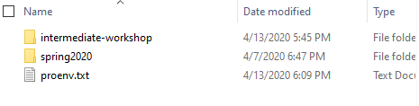
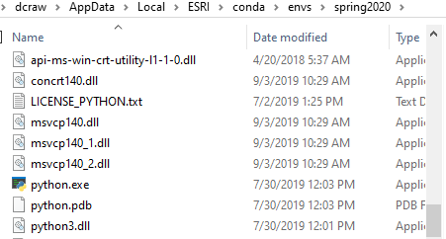
What Creating a New Environment Does
Makes a new unique installation of python
Allows you to modify the environment without harming your root environment

Slide 6
Extra Fun
Create your own environment in ArcGIS Pro
Sign up for an ArcGIS Online Developer Account

Slide 7

ArcGIS Online Basics

Slide 8
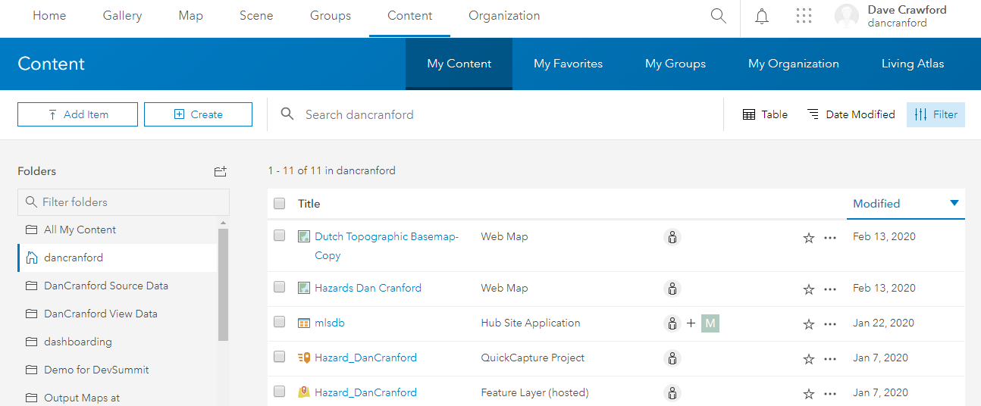
ArcGIS Online Basics

Slide 9

ArcGIS Online Basics
Items
Data
Feature Layers
Tile Layers
Web Maps
Web Mapping Applications
Dashboards
Users
Groups

Slide 10
ArcGIS API for Python
Created in 2016
Specifically geared for ArcGIS Online
Administration
User Management
Group Management
Item Management
Analysis
Quick analysis with vector data
Built-in Notebook widgets
Geared toward data scientists
Rapidly expanding raster and machine-learning/AI functionality

Slide 11
arcpy vs. arcgis
arcpy
Has licensing
Only exists with ArcGIS Desktop/ArcGIS Pro
Good for complex geoprocessing
Good for desktop datasets
Available in Python 2.7 and Python 3.x
Mostly functions
Arcgis API for Python (arcgis)
Free to use
Frequently updated
Mostly for ArcGIS Online data
Does not require ArcGIS Pro* or ArcGIS Desktop
Only available in Python 3.x
Very object-oriented

